Slide 1
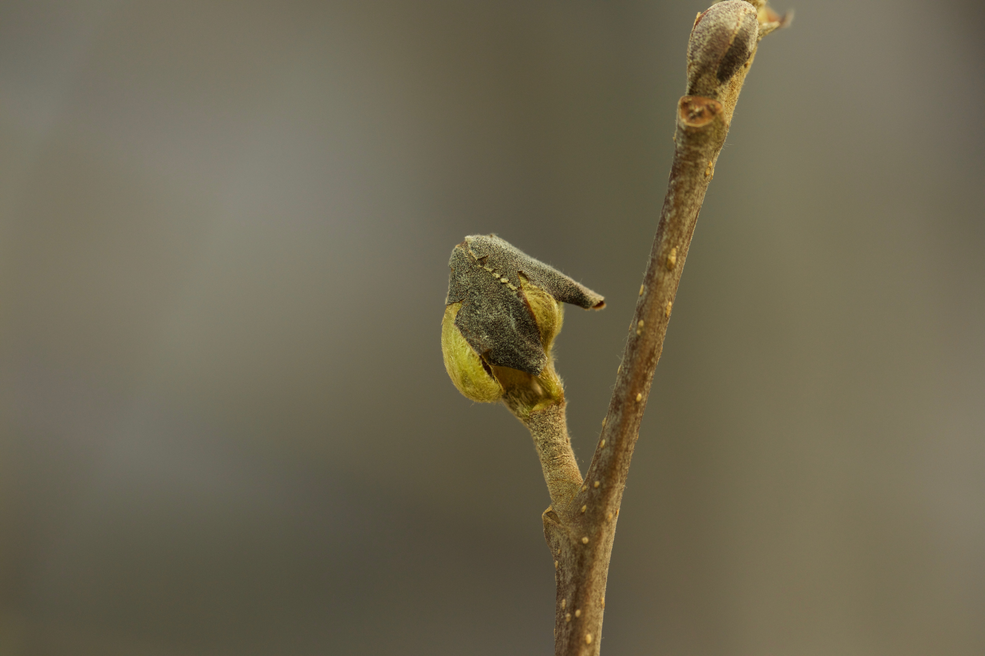
Climate change reshapes the drivers of false spring risk in European trees
Cat Chamberlain

Slide 2
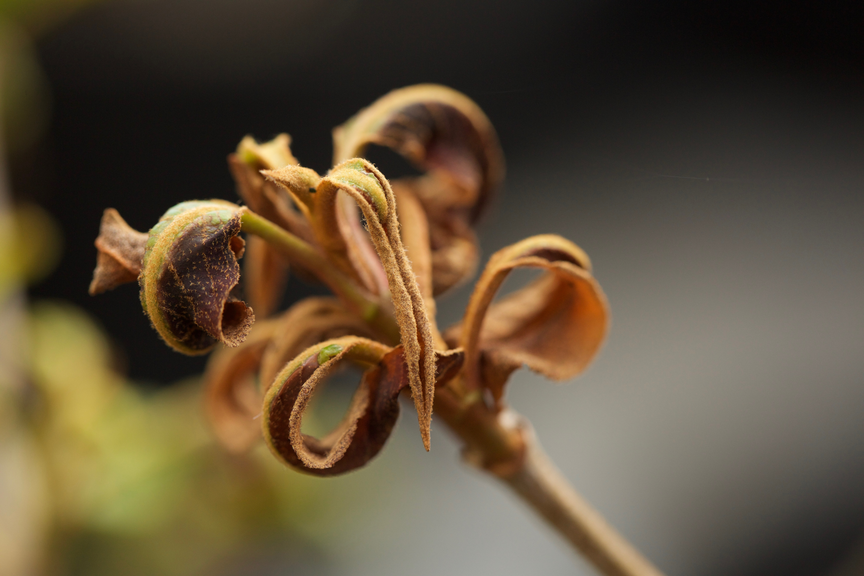
Climate change reshapes the drivers of false spring risk in European trees
Cat Chamberlain
Arnold Arboretum – Harvard University

Slide 3
Climate change reshapes the drivers of false spring risk in European trees
Cat Chamberlain
Arnold Arboretum – Harvard University

Slide 4
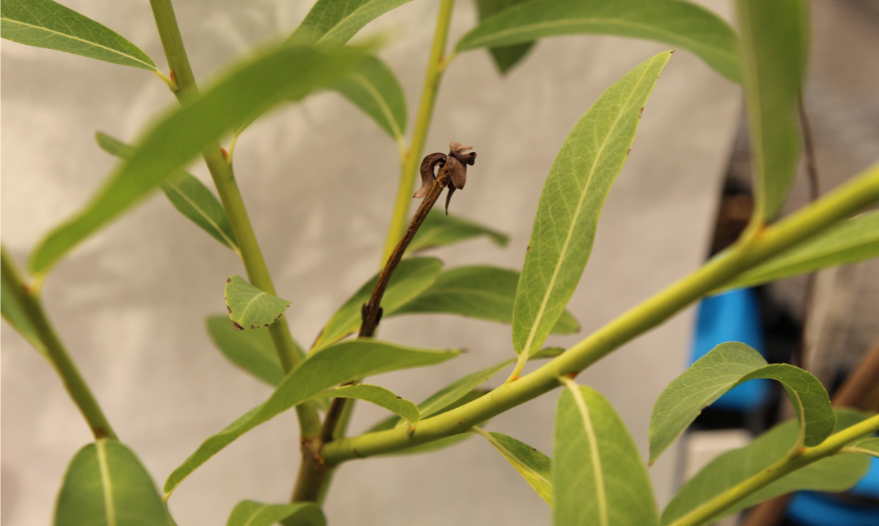
Climate change reshapes the drivers of false spring risk in European trees
Cat Chamberlain
Arnold Arboretum – Harvard University

Slide 5
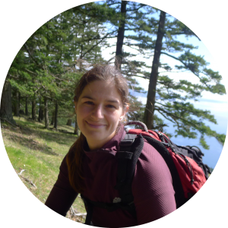
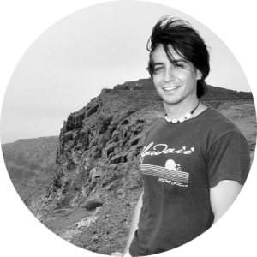
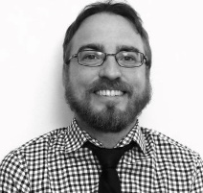

Slide 6
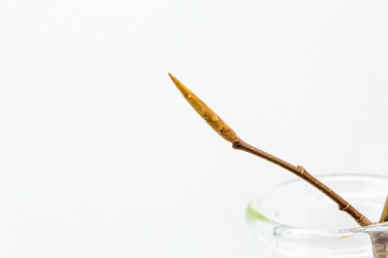
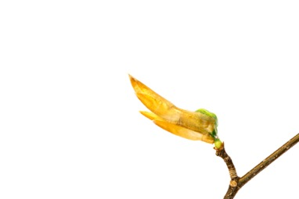
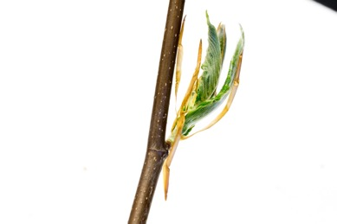
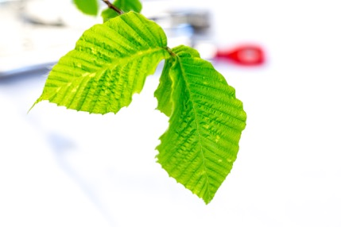
American Beech: Fagus sylvatica
DORMANT BUD
BUDBURST
LEAFOUT

Slide 7
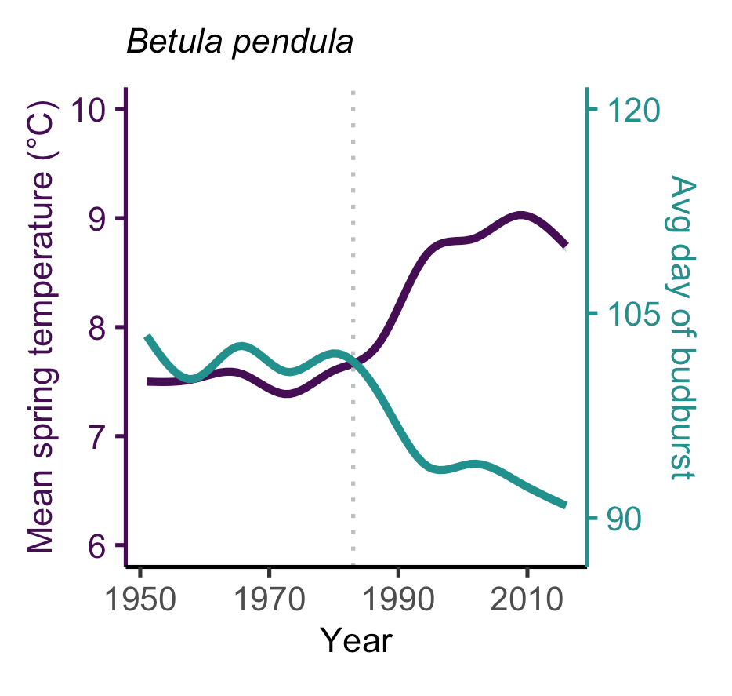
PHENOLOGY IS ADVANCING
Chamberlain et al, in prep

Slide 8
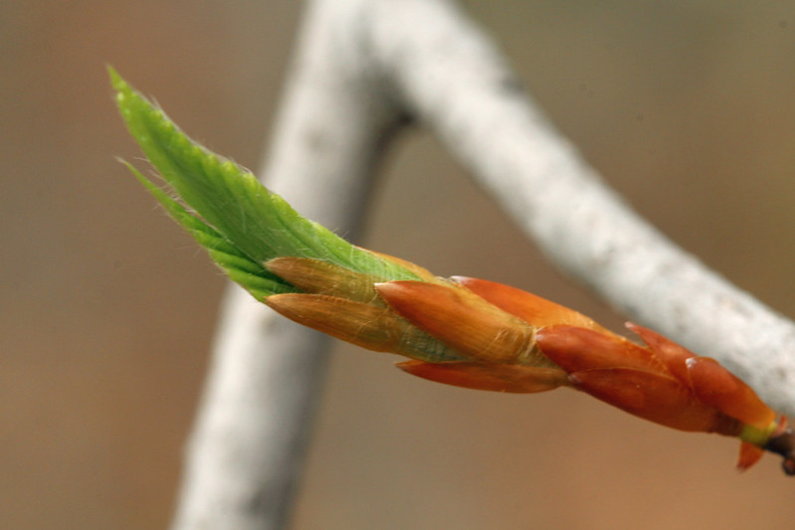
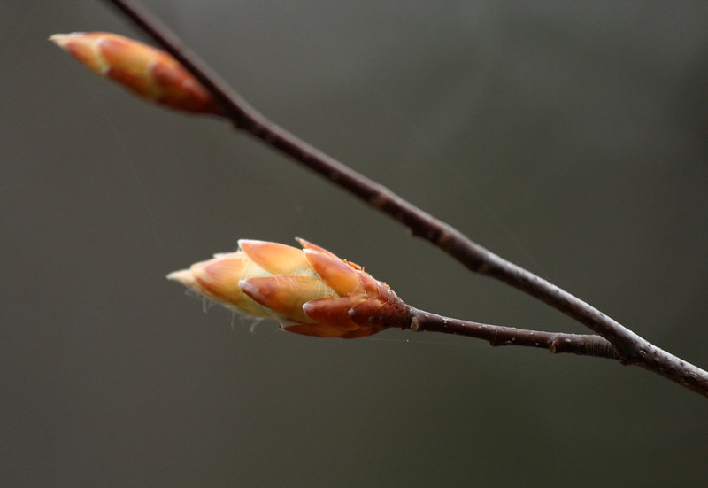
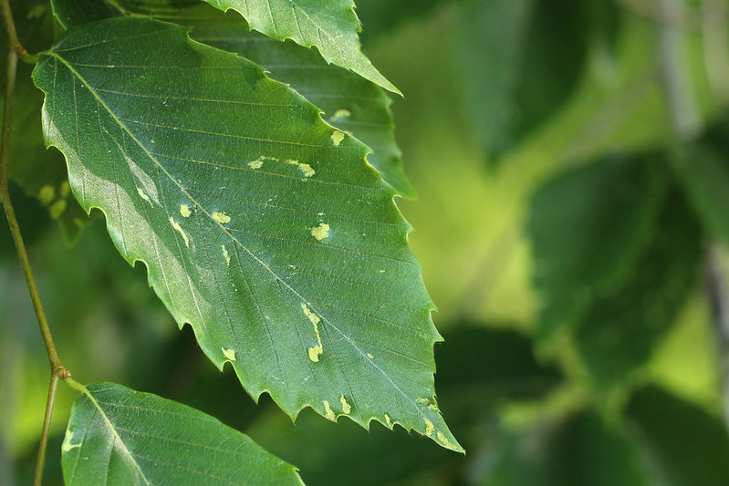
False Springs:
BUDBURST
LEAFOUT
DURATION OF VEGETATIVE RISK
Chamberlain et al, 2019 GCB
Photos by Suz Mrozak

Slide 9
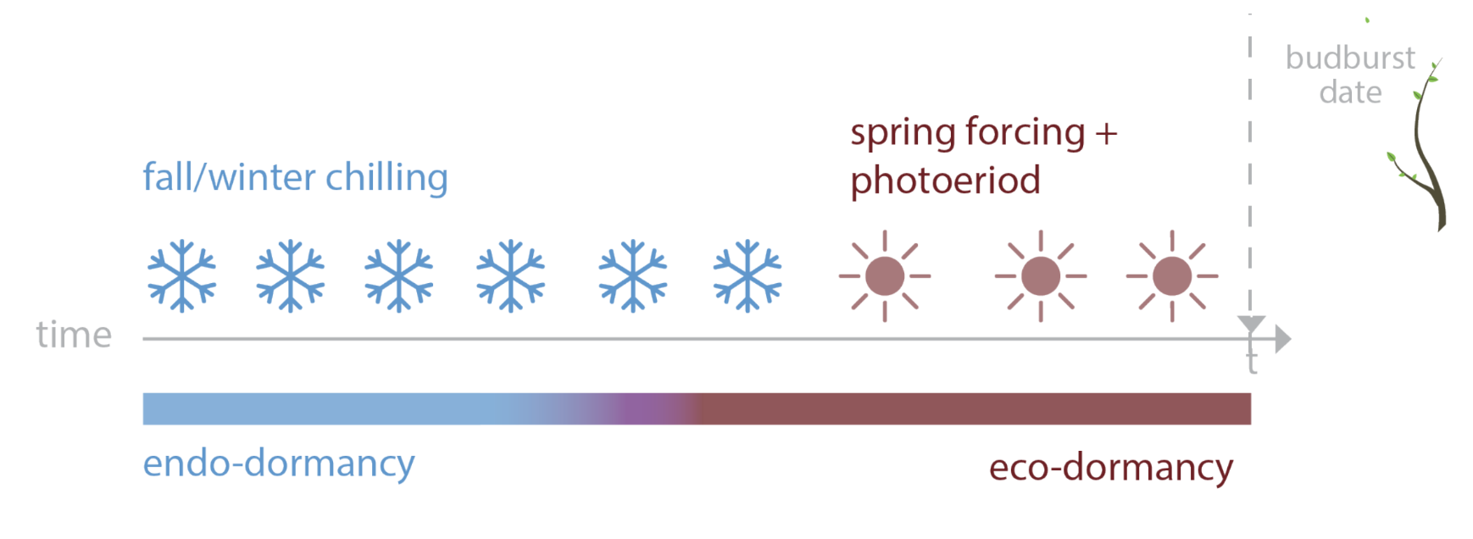

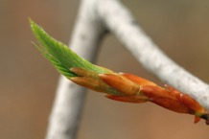
PHENOLOGY USES MULTIPLE CUES
spring warming + daylength
Ettinger et al, in review

Slide 10
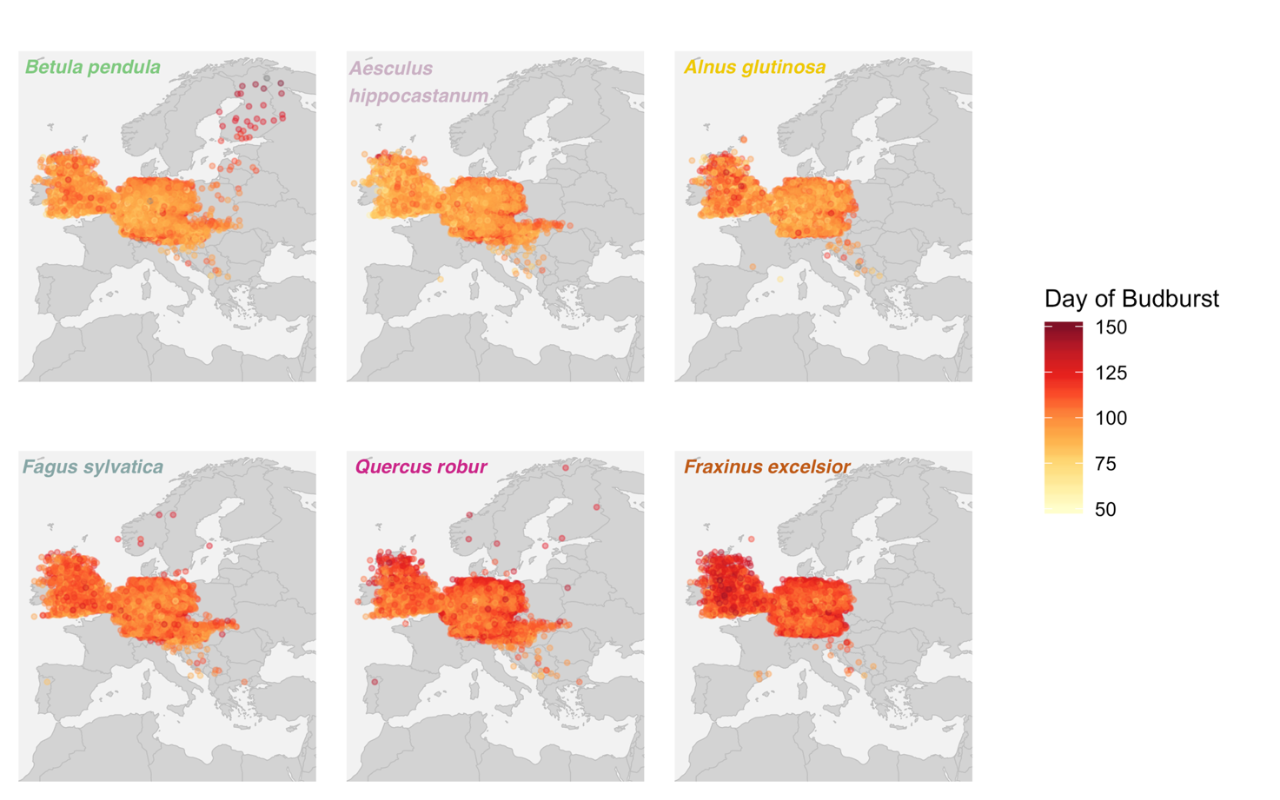
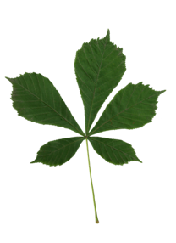

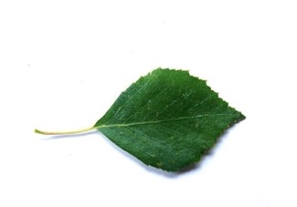
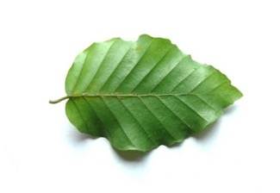
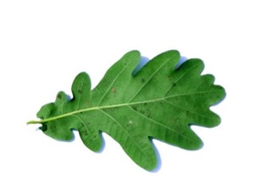
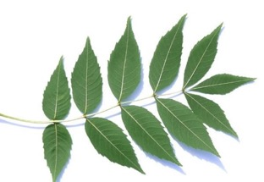
Are false spring events changing with warming?

Slide 11
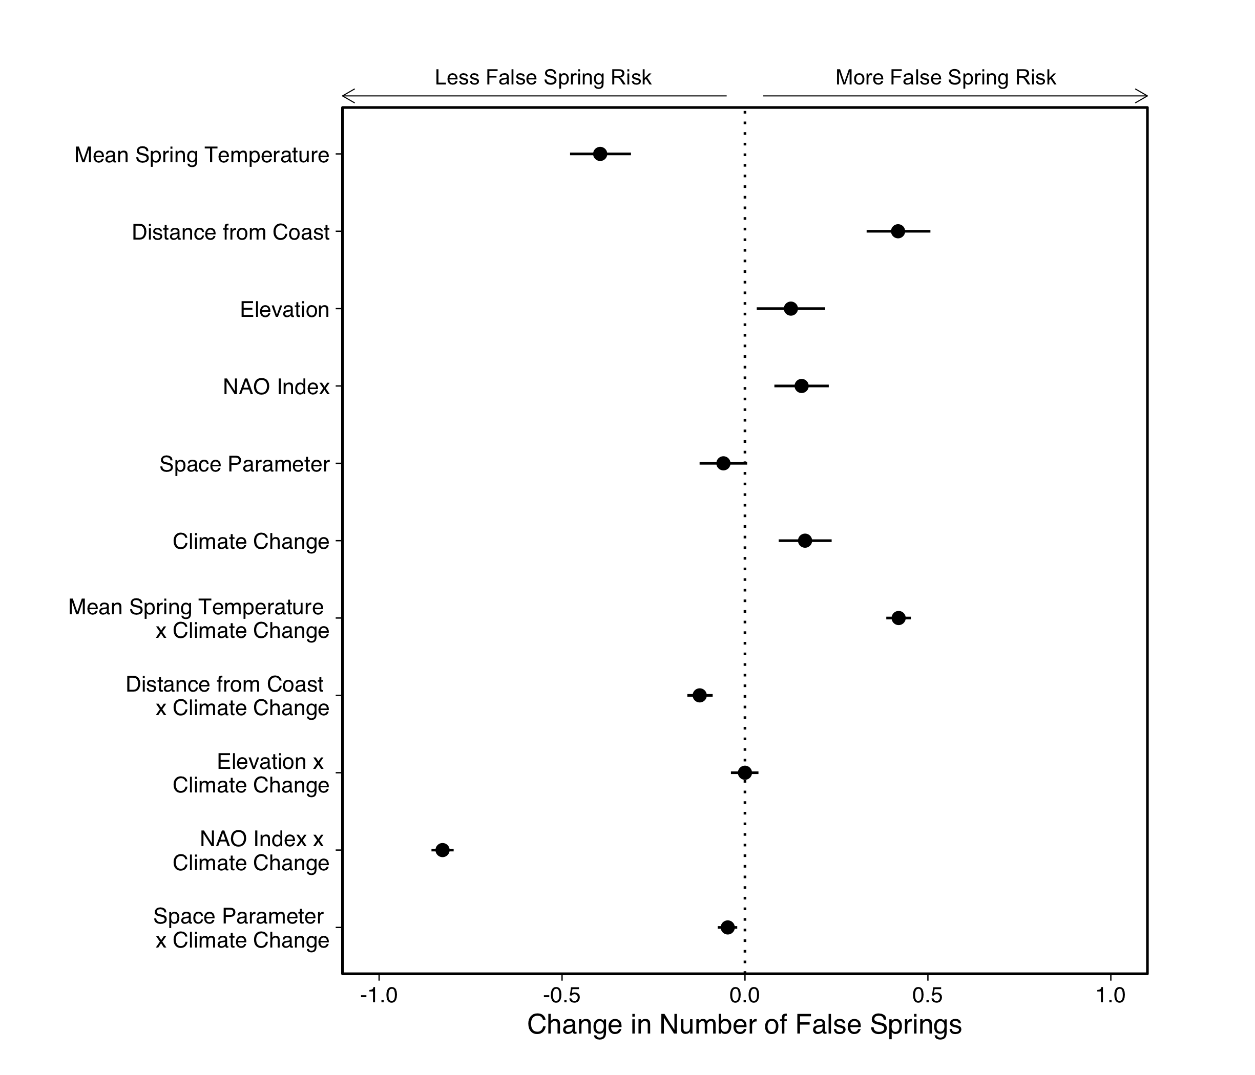
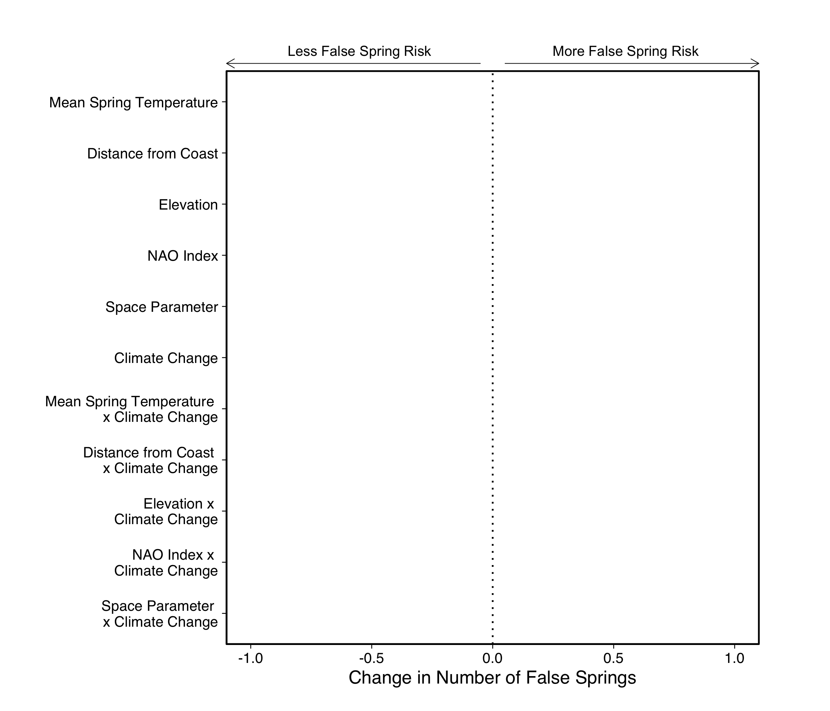

Slide 12
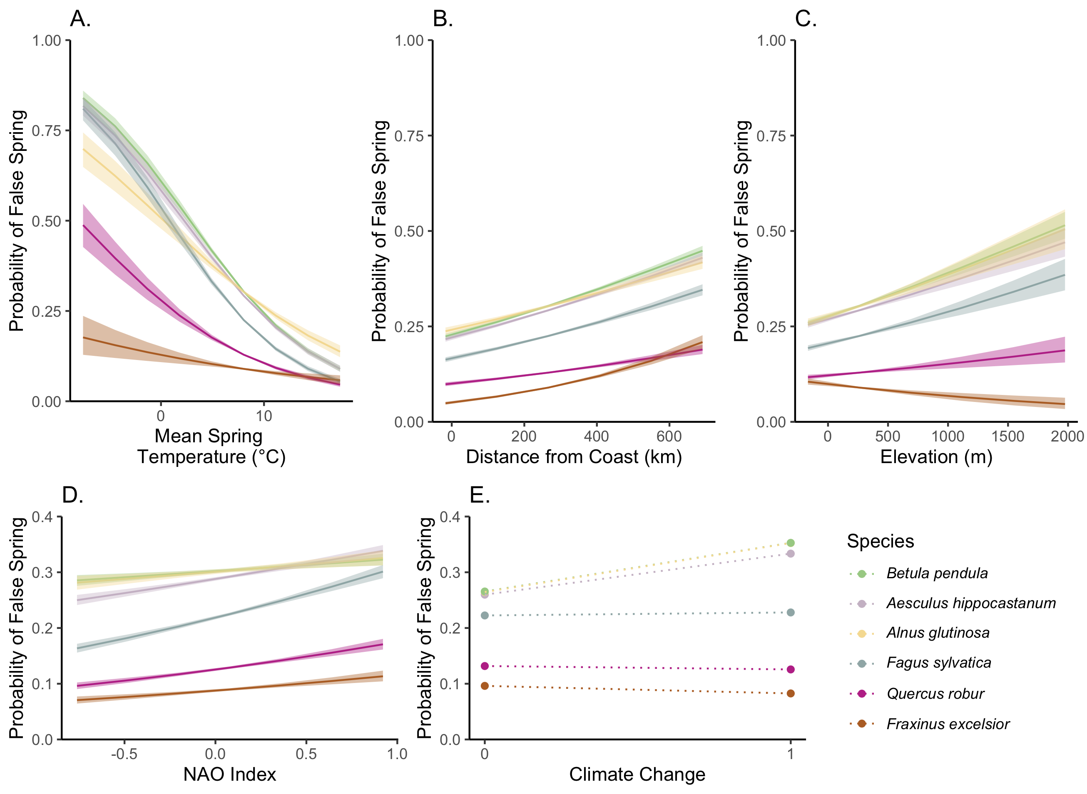

Slide 13









THE TEMPORAL ECOLOGY LAB
Lizzie Wolkovich, PhD
Dan Buonaiuto
Ignacio Morales-Castilla, PhD
Aileen Ettinger, PhD
Deirdre Loughnan
Darwin Sodhi
ARNOLD ARBORETUM - TREE SPOTTERS
Suz Mrozak
Danny Schissler
Kate Stonefoot
Pam Thompson
Our Citizen Scientists!!
COMMITTEE MEMBERS
Paul Moorcroft, PhD
Neil Pederson, PhD
COLLABORATORS AND SPECIAL THANKS
Iñaki Garcia de Cortazar-Atauri, PhD
Ben Cook, PhD
Kea Woodruff
Faye Rosin
Alice Linder
Dan Flynn
Alissandra Ayala
John O’Keefe, PhD
Audrey Barker Plotkin
THE HOLBROOK LAB
Noel Michele Holbrook, PhD
Fulton Rockwell, PhD
Jess Gersony
Anju Manandhar
Meghan Blumstein
Morgan Furze, PhD
Zhe He

Slide 14
